Slide 1


Noida Institute of Engineering and Technology, Greater Noida
Operating Systems
ACSE0403A
Unit: 1
Operating System
Surbhi Jha
Assistant Professor
Dept. of CSE
B Tech 4th Sem

Slide 2
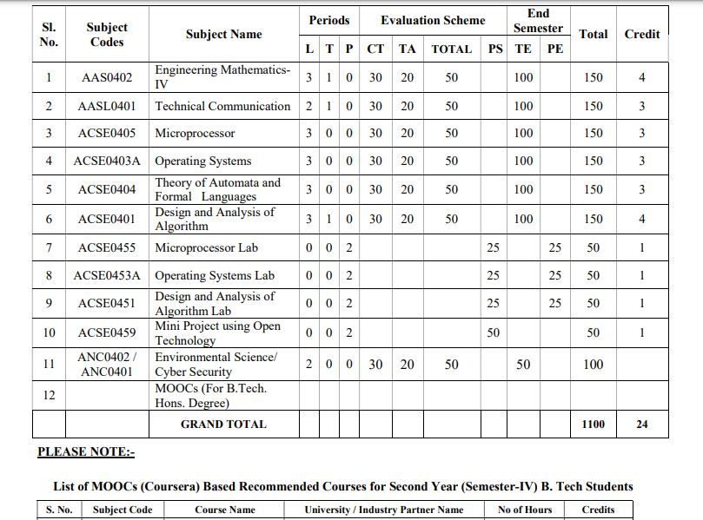
Evaluation Scheme

Slide 3

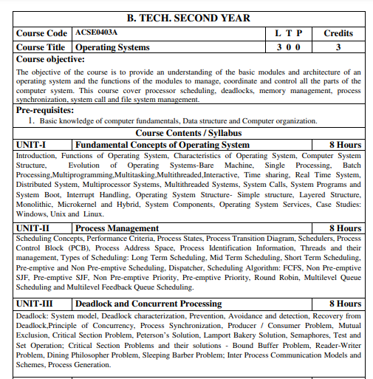
Subject Syllabus
3

Slide 4

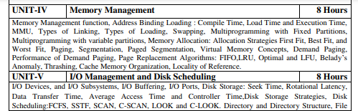

Subject Syllabus
4

Slide 5
Syllabus For Unit 2
UNIT-I Fundamental Concepts of Operating System
Introduction, Functions of Operating System, Characteristics of Operating System, Computer System Structure, Evolution of Operating Systems-Bare Machine, Single Processing, Batch Processing,Multiprogramming,Multitasking,Multithreaded,Interactive, Time sharing, Real Time System, Distributed System, Multiprocessor Systems, Multithreaded Systems, System Calls, System Programs and System Boot, Interrupt Handling, Operating System Structure- Simple structure, Layered Structure, Monolithic, Microkernel and Hybrid, System Components, Operating System Services, Case Studies: Windows, Unix and Linux.

Slide 6
Branch wise Applications
Airlines reservation system.
Air traffic control system.
Systems that provide immediate updating.
Used in any system that provides up to date and minute
information on stock prices.
Defense application systems like RADAR.
Networked Multimedia Systems.
Command Control Systems.

Slide 7

Course Objectives
To learn the fundamentals of Operating Systems.
To understand what a process is and how processes are synchronized and scheduled.
To understand different approaches to memory management.
Students should be able to use system calls for managing processes, memory and the file system.
To understand the structure and organization of the file system.

Slide 8
Course Outcomes
Course outcome: After completion of this course students will be able to:
CO 1 | Understand the fundamentals of an operating systems, functions and their structure and functions. | K1, K2
CO2 | Implement concept of process management policies, CPU Scheduling and thread management. | K5
CO3 | Understand and implement the requirement of process synchronization and apply deadlock handling algorithms. | K2,K5
CO4 | Evaluate the memory management and its allocation policies. | K5
CO5 | Understand and analyze the I/O management and File systems | K2, K4

Slide 9
Program Outcomes
Engineering knowledge
Problem analysis
Design/development of solutions
Conduct investigations of complex problems
Modern tool usage
The engineer and society
Environment and sustainability
Ethics:
Individual and team work
Communication
Project management and finance
Life-long learning

Slide 10
COs and POs Mapping
OPERATING SYSTEM (ACSE0403A )
CODE | PO1 | PO2 | PO3 | PO4 | PO5 | PO6 | PO7 | PO8 | PO9 | PO10 | PO11 | PO12
ACSE0403A .1 | 3 | 3 | 2 | 2 | 1 | 2 | - | 2 | 3 | 2 | 2 | 3
ACSE0403A .2 | 3 | 3 | 3 | 2 | 2 | 3 | 2 | 2 | 3 | - | 1 | 3
ACSE0403A .3 | 3 | 3 | 2 | 2 | 2 | 2 | 2 | 2 | 2 | 3 | 1 | 3
ACSE0403A .4 | 3 | 2 | 2 | 3 | 1 | 2 | 2 | - | 2 | - | 2 | 3
ACSE0403A .5 | 3 | 1 | 2 | 2 | 2 | 2 | - | - | 2 | 2 | 2 | 3

Slide 11
Program Specific Outcomes
On successful completion of B. Tech. (CSE) Program, the Computer Science graduates will be able to:
PSO1: The ability to identify, analyze real world problems and design their ethical solutions using artificial intelligence, robotics, virtual/augmented reality, data analytics, block chain technology and cloud computing.
PSO2: The ability to design and develop the hardware sensor devices and related interfacing software systems for solving complex engineering problems.
PSO 3: The ability to understand inter disciplinary computing techniques and to apply them in the design of advanced computing.
PSO 4: The ability to conduct investigation of complex problem with the help of technical, managerial, leadership qualities, and modern engineering tools provided by industry sponsored laboratories.

Slide 12
COs and PSOs Mapping
Course Outcomes | Program Specific Outcomes
 | PSO1 | PSO2 | PSO3 | PSO4
ACSE0403A .1 | 2 | 1 | 2 | 2
ACSE0403A .2 | 2 | 2 | 1 | 2
ACSE0403A .3 | 2 | 3 | 3 | 2
ACSE0403A .4 | 2 | 2 | 1 | 2
ACSE0403A .5 | 2 | 2 | 2 | 2

Slide 13
Program Educational Objectives (PEOs)
PEO 1: To have an excellent scientific and engineering breadth so as to comprehend, analyze, design and provide sustainable solutions for real life problems using state of the art technologies.
PEO 2: To have a successful career in industries, to pursue higher studies or to support entrepreneurial endeavors and to face the global challenges.
PEO 3: To have an effective communication skills, professional attitude, ethical values and a desire to learn specific knowledge in emerging trends, technologies for research, innovation and product development and contribution to society.
PEO 4: To have life-long learning for up-skilling and re-skilling for successful professional career as engineer, scientist, entrepreneur and bureaucrat for betterment of society.

Slide 14

CO-PO and PSO Mapping
S. No. | Program Outcomes (PO) | PO Description
1 | PO1 (Engineering Knowledge) | Apply the knowledge of mathematics, science, engineering fundamentals and an engineering specialization to the solution of complex engineering problems.
2 | PO2 (Problem Analysis) | Identify, formulate, review research literature, and analyze complex engineering problems reaching substantiated conclusions using first principles of mathematics, natural sciences and engineering sciences.
3 | PO3 (Design/Development of solutions) | Design solutions for complex engineering problems and design system components or processes that meet the specified needs with appropriate considerations for the public health and safety, and the cultural, societal and environmental considerations.

Slide 15
CO-PO and PSO Mapping
4 | PO4 (Conduct Investigations of complex problems) | Use research based knowledge and research methods including design of experiments, analysis and interpretation of data and synthesis of the information to provide valid conclusions.
5 | PO5 (Modern tool usage) | Create, select and apply appropriate techniques, resources and modern engineering and IT tools including prediction and modeling to complex engineering activities with an understanding of the limitations.
6 | PO6 (The engineer and society) | Apply reasoning informed by the contextual knowledge to assess societal, health, safety, legal and cultural issues and consequent responsibilities relevant to the professional engineering practice.
7 | PO7 (Environment and sustainability) | Understand the impact of the professional engineering solutions in societal and environmental contexts, demonstrate the knowledge of, and need for sustainable development.

Slide 16
CO-PO and PSO Mapping
8 | PO8 (Ethics) | Apply the ethical principles and commit to professional ethics, responsibilities, and norms of engineering practice.
9 | PO9 (Individual and team work) | Function effectively as an individual, and as a member or leader in diverse teams and multidisciplinary settings.
10 | PO10 (Communication) | Communicates effectively on complex engineering activities with the engineering community and with society such as being able to comprehend and write effective reports and design documentation, make effective presentations and give and receive clear instructions.

Slide 17
Faculty wise Result Analysis
Semester & Section | Subject Code | Result
VIII(A+B+C+D) | KOE 094 | 100%

Slide 18
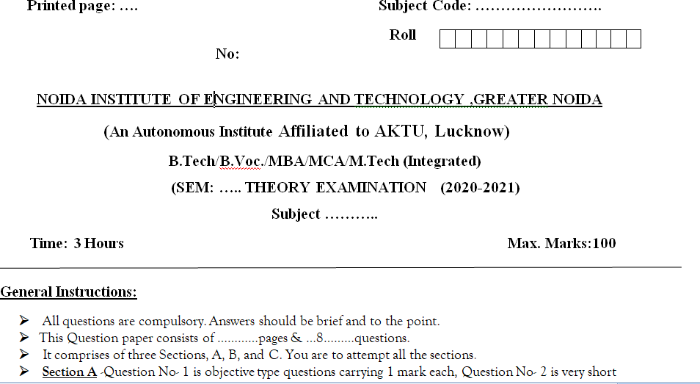
End Semester Question Paper Templates (Offline
Pattern/Online Pattern

Slide 19
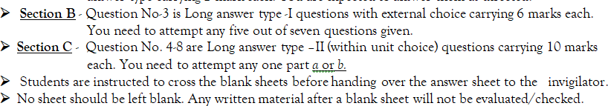
End Semester Question Paper Templates (Offline
Pattern/Online Pattern

Slide 20

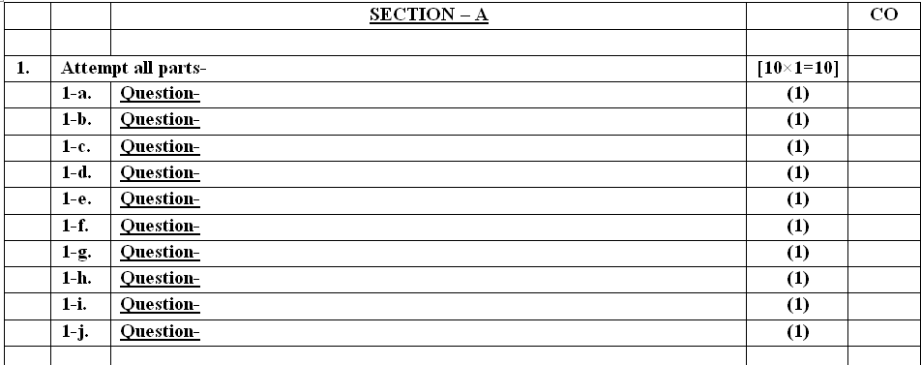
End Semester Question Paper Templates (Offline
Pattern/Online Pattern

Slide 21
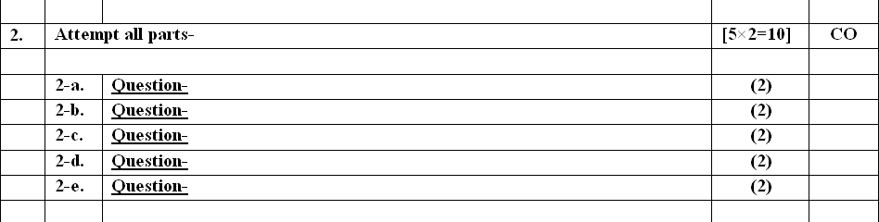
End Semester Question Paper Templates (Offline
Pattern/Online Pattern

Slide 22

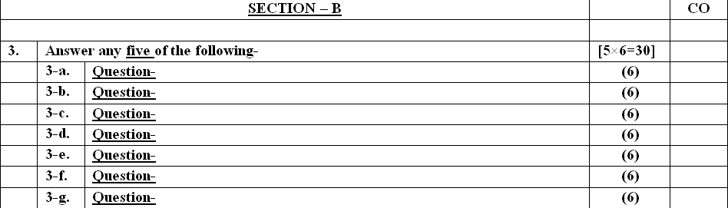
End Semester Question Paper Templates (Offline
Pattern/Online Pattern

Slide 23

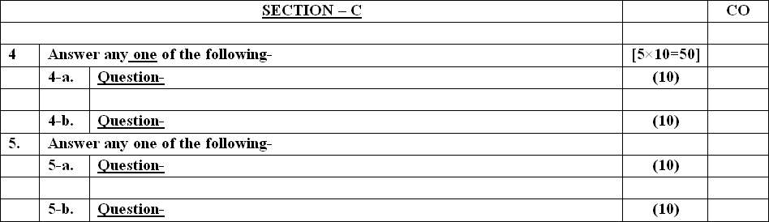
End Semester Question Paper Templates (Offline
Pattern/Online Pattern

Slide 24


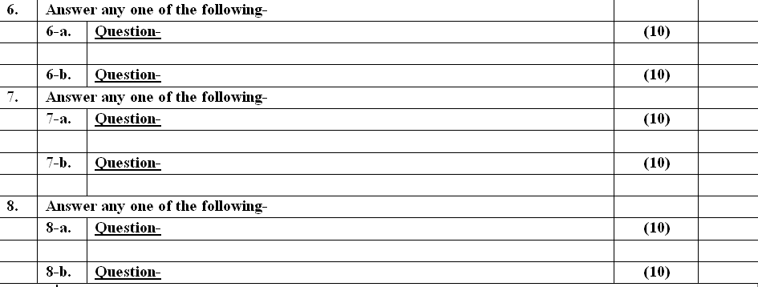
End Semester Question Paper Templates (Offline
Pattern/Online Pattern

Slide 25
Prerequisite and Recap
Basic knowledge of computer fundamentals.
Basic knowledge of computer organization.
Memory hierarchy
Cache Organization
Interrupt
Registers
Associative memory

Slide 26

Brief Introduction about the subject with video
An operating system acts as an intermediary between the user of a computer and computer hardware. The purpose of an operating system is to provide an environment in which a user can execute programs conveniently and efficiently
YouTube/other Video Links
https://www.youtube.com/watch?v=YwqexcfbucE&list=PLmXKhU9FNesSFvj6gASuWmQd23Ul5omtD&index=1

Slide 27
Unit-1 Content
Introduction
Functions of Operating System
Characteristics of Operating System
Computer System Structure,
Evolution of Operating Systems-Bare Machine,
Types of Operating Systems
Simple Batch Systems
Multiprogramming Batched Systems
Time-Sharing Systems
Real -Time Systems
Parallel Systems
Distributed Systems
Multiprocessor Systems
Multithreaded Systems

Slide 28
Unit-1 Content
System Calls
System Programs
System Boot
Interrupt Handling
Operating System Structure
Operating System Services
Case Studies
Windows
Unix
Linux.

Slide 29
Unit-1 Objective
After going through this unit, students will be able to:
Understand the concept of Operating System
And Types of Operating System
Understand the concept of Interrupt Handling
Understand the components and internal structure of operating system
Understand the different types of Operating System Services.

Slide 30
Course Outcome of Unit 1
After completion of this course students will be able to:
CO1: Understand the fundamentals of an operating systems, functions and their structure and functions.

Slide 31
Topic mapping with CO
Topic | CO
Introduction to Operating System | CO1
Types of operating System | CO1
Interrupt Handling | CO1
Operating System Structure | CO1
Operating System Services | CO1

Slide 32
Topic Objectives
Topic | Objective
 | Students will be able to
Introduction of Operating System | Understand the basics of Operating System, its features characteristics and functions
Types of operating System | Understand the different types of operating System
Interrupt Handling | Understand the operating system concepts
Operating System Structure | Understand the components and internal structure of operating system
Operating System Services | Know the different types of operating system services

Slide 33
Introduction of Operating System
A program that acts as an intermediary between a user of a computer and the computer hardware.
An operating system is a program that controls the execution of application programs and acts as an interface between the user of a computer and the computer hardware.
Operating system goals:
Execute user programs and make solving user problems easier.
Make the computer system convenient to use.
Use the computer hardware in an efficient manner.

Slide 34
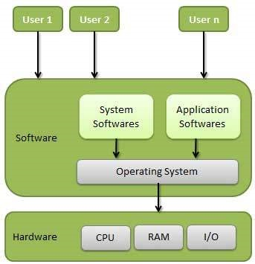
Introduction of Operating System

Slide 35
Objectives of Operating System
Convenience – An operating system improves the use of a machine. Operating systems enable users to get started on the things they wish to complete quickly without having to cope with the stress of first configuring the system.
Efficiency – An operating system enables the efficient use of resources. This is due to less time spent configuring the system.
Ability to evolve – An operating system should be designed in such a way that it allows for the effective development, testing, and introduction of new features without interfering with service.
Throughput: An OS should be constructed so that it can give maximum throughput(Number of tasks per unit time).
Management of system resources – It guarantees that resources are shared fairly among various processes and users.

Slide 36
Need of Operating System
1. Interface between the user and the computer
An OS provides a very easy way to interact with the computer. It provides different features and GUI so that we can easily work on a computer. We have to interact just by clicking the mouse or through the keyboard. Thus, we can say that an OS makes working very easy and efficient.
2. Booting
Booting is basically the process of starting the computer. When the CPU is first switched ON it has nothing inside the memory. So, to start the computer, we load the operating system into the main memory. Therefore, loading the OS to the main memory to start the computer is booting. Hence, the OS helps to start the computer when the power is switched ON.
3. Managing the input/output devices
The OS helps to operate the different input/output devices. The OS decides which program or process can use which device. Moreover, it decides the time for usage. In addition to this, it controls the allocation and de allocation of devices.
4. Multitasking
The OS helps to run more than one application at a time on the computer. It plays an important role while multitasking. Since it manages memory and other devices during multitasking. Therefore, it provides smooth multitasking on the system.

Slide 37
Need of Operating System
5. Platform for other application software
Users require different application programs to perform specific tasks on the system. The OS manages and controls these applications so that they can work efficiently. In other words, it acts as an interface between the user and the applications.
Some other uses/need for operating system are:
6. Manages the memory
It helps in managing the main memory of the computer. Moreover, It allocates and de allocates memory to all the applications/tasks.
7. Manages the system files
It helps to manage files on the system. As we know, all the data on the system is in the form of files. It makes interaction with the files easy.
8. Provides Security
It keeps the system and applications safe through authorization. Thus, the OS provides security to the system.

Slide 38
Daily Quiz
What is an Operating Systems ?
What is the goals of an Operating Systems ?
Name a few Operating Systems available (Commonly Encounters).
What are the main services of functions of an Operating Systems.
What are the various objective of an Operating Systems.

Slide 39
Daily Quiz
What is an operating system? a) interface between the hardware and application programs b) collection of programs that manages hardware resources c) system service provider to the application programs d) all of the mentioned
2. What is the main function of the command interpreter? a) to provide the interface between the API and application program b) to handle the files in the operating system c) to get and execute the next user-specified command d) none of the mentioned

Slide 40
Functions of Operating System
Security – For security, modern operating systems employ a firewall. A firewall is a type of security system that monitors all computer activity and blocks it if it detects a threat.
Job Accounting – As the operating system keeps track of all the functions of a computer system. Hence, it makes a record of all the activities taking place on the system. It has an account of all the information about the memory, resources, errors, etc. Therefore, this information can be used as and when required.
Control over system performance – The operating system will collect consumption statistics for various resources and monitor performance indicators such as reaction time, which is the time between requesting a service and receiving a response from the system.
Error detecting aids – While a computer system is running, a variety of errors might occur. Error detection guarantees that data is delivered reliably across susceptible networks. The operating system continuously monitors the system to locate or recognize problems and protects the system from them.
Coordination between other software and users – The operating system (OS) allows hardware components to be coordinated and directs and allocates assemblers, interpreters, compilers, and other software to different users of the computer system.
Booting process – The process of starting or restarting a computer is referred to as Booting. Cold booting occurs when a computer is totally turned off and then turned back on. Warm booting occurs when the computer is restarted. The operating system (OS) is in charge of booting the computer.

Slide 41
Characteristics of Operating System
Memory Management — It keeps tracks of primary memory i.e what part of it are in use by whom, what part are not in use etc. Allocates the memory when the process or program request it.
Processor Management — Allocate the processor(CPU) to a process. De allocate processor when processor is no longer required.
Device Management — Keep tracks of all devices. This is also called I/O controller. Decides which process gets the device when and for how much time.
File Management — Allocates the resources. De-allocates the resource. Decides who gets the resources.
Security — By means of passwords & similar other techniques, preventing unauthorized access to programs & data.
Error-detecting aids — Production of dumps, traces, error messages and other debugging and error-detecting methods.
Storage Management

Slide 42
Characteristics of Operating System
Memory Management:
It is the management of the main or primary memory. Whatever program is executed, it has to be present in the main memory. Main memory is a quick storage area that may be accessed directly by the CPU. When the program execution is completed, the memory region is released and can be used by other programs. Therefore, there can be more than one program present at a time. Hence, it is required to manage the memory.
The operating system:
Allocates and de allocates the memory.
Keeps a record of which part of primary memory is used by whom and how much.
Distributes the memory while multiprocessing.
In multiprogramming, the operating system selects which processes acquire memory when and how much memory they get.

Slide 43
Characteristics of Operating System
Processor Management:
Every software that runs on a computer, whether in the background or in the frontend, is a process. Processor management is an execution unit in which a program operates. The operating system determines the status of the processor and processes, selects a job and its processor, allocates the processor to the process, and de-allocates the processor after the process is completed.
When more than one process runs on the system, the OS decides how and when a process will use the CPU. Hence, the name is also CPU Scheduling.
The OS:
Allocates and de allocates processor to the processes.
Keeps record of CPU status.
Certain algorithms used for CPU scheduling are as follows:
First Come First Serve (FCFS)
Shortest Job First (SJF)
Round-Robin Scheduling
Priority-based scheduling etc.

Slide 44
Characteristics of Operating System
Device Management:
An operating system regulates device connection using drivers. The processes may require devices for their use. This management is done by the OS.
The OS:
Allocates and de allocates devices to different processes.
Keeps records of the devices.
Decides which process can use which device for how much time.
File Management:
The operating system manages resource allocation and de-allocation. It specifies which process receives the file and for how long. It also keeps track of information, location, uses, status, and so on. These groupings of resources are referred to as file systems. The files on a system are stored in different directories.
The OS:
Keeps records of the status and locations of files.
Allocates and de allocates resources.
Decides who gets the resources.

Slide 45
Characteristics of Operating System
Storage Management:
Storage management is a procedure that allows users to maximize the utilization of storage devices while also protecting data integrity on whatever media on which it lives. Network virtualization, replication, security, compression, de duplication, traffic analysis, process automation, storage provisioning, and memory management are some of the features that may be included.
The operating system is in charge of storing and accessing files. The creation of files, the creation of directories, the reading and writing of data from files and directories, as well as the copying of the contents of files and directories from one location to another are all included in storage management.
The OS uses storage management for:
Improving the performance of the data storage resources.
It optimizes the use of various storage devices.
Assists businesses in storing more data on existing hardware, speeding up the data retrieval process, preventing data loss, meeting data retention regulations, and lowering IT costs.

Slide 46
Daily Quiz
Write down various functions of an Operating System.
Write down characteristics of an Operating System.
Briefly explain about Processor Management.
Briefly explain about Storage Management.
Explain about File Management.

Slide 47
Daily Quiz
To access the services of the operating system, the interface is provided by the ___________ a) Library b) System calls c) Assembly instructions d) API
Which one of the following errors will be handle by the operating system? a) lack of paper in printer b) connection failure in the network c) power failure d) all of the mentioned

Slide 48
Computer System Structure
Computer-System Operation
I/O Structure
Storage Structure
Storage Hierarchy
Hardware Protection
General System Architecture

Slide 49
Computer System Operation
A modern computer system consists of a CPU, memory, system bus and a number of device controllers.
I/O devices and the CPU can execute concurrently.
Each device controller is in charge of a particular device type.
A device controller for each device contains local buffer storage and special purpose registers.
A bootstrap program is required to initialize the computer system.
CPU moves data from /to main memory and to/from local buffers.
I/O is from the device to local buffer of controller.
Device controller informs CPU that it has finished its operation by causing an interrupt.

Slide 50
I/O Structure
The Computer System has a number of device controllers connected through a common bus.
A device controller contains local buffer storage and a set of special purpose registers.
The device driver is responsible for moving the data between the peripheral devices and it controls its local buffer storage.
I/O interrupts are used by the device controllers for transfer of data.
I/O methods
a) Synchronous
b) Asynchronous
In synchronous method , after I/O starts, control returns to user program only upon I/O completion.
In asynchronous method, after I/O starts, control returns to user program without waiting for I/O completion. It requires system call which is a request to the operating system to allow user to wait for I/O completion.

Slide 51
Storage Structure
Registers
Cache Memory
Main Memory
Electronic Disk
Magnetic Disk
Optical Disk
Hard Disk
Magnetic Tape

Slide 52
Storage Hierarchy
Storage Systems can be organized in a hierarchy according to:
a) Speed
b) Cost
c) Capacity
d) Volatility
Registers, Cache and Memory are constructed using semiconductor memory and are volatile.
Electronic disks can be volatile or nonvolatile.
All secondary storage devices(magnetic disk, optical disk, floppy disk , magnetic tapes, etc.) are non-volatile.

Slide 53
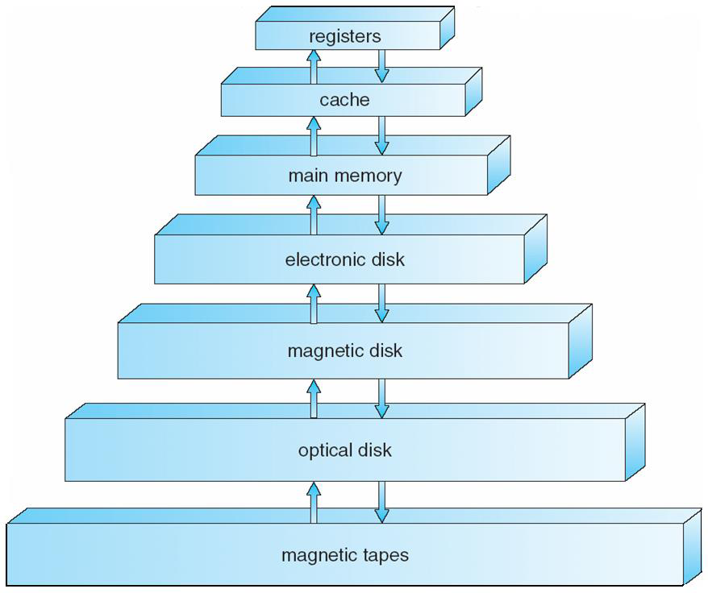
Storage Device Hierarchy

Slide 54
Hardware Protection
I/O Protection
Memory Protection
CPU Protection
I/O Protection :
a) All I/O instructions are defined as privileged instructions so users cannot issue I/O
instructions from user mode.
b) To do I/O , a user program executes a system call to request that the OS perform
I/O on its behalf and returns the control to the users after completion of I/O
operation.
Memory Protection:
Two registers are used to determine the range of legal addresses a program may access:
1. Base register: holds the smallest legal physical memory address.
2. Limit register: contains the size of the range

Slide 55
Hardware Protection
CPU Protection :
A user program may:
a) be stuck in an infinite loop
b) fail to call system services
c) fail to return control to the OS.
Timer: Interrupts computer after specified period to ensure operating system maintains control.
Timer is also commonly used to implement time sharing mechanism.
Timer can be used to compute the current time.

Slide 56
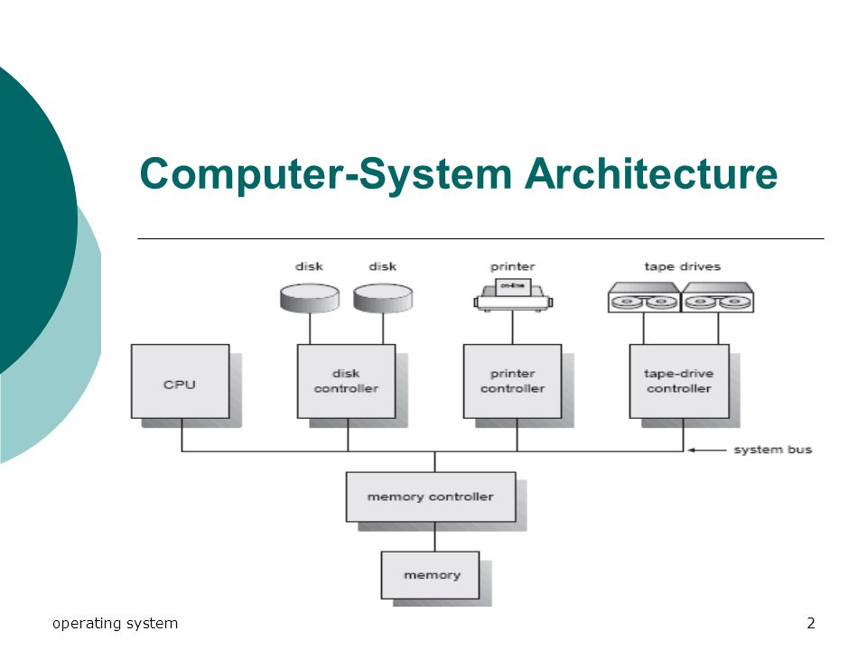
General System Architecture

Slide 57
Computer System Components(CO1)
1. Hardware – provides basic computing resources (CPU, memory, I/O devices).
2. Operating system – controls and coordinates the use of the hardware among the various application programs for the various users.
3. Application programs – define the ways in which the system resources are used to solve the computing problems of the users (compilers, database systems, video games, business programs).
4. Users (people, machines, other computers).

Slide 58
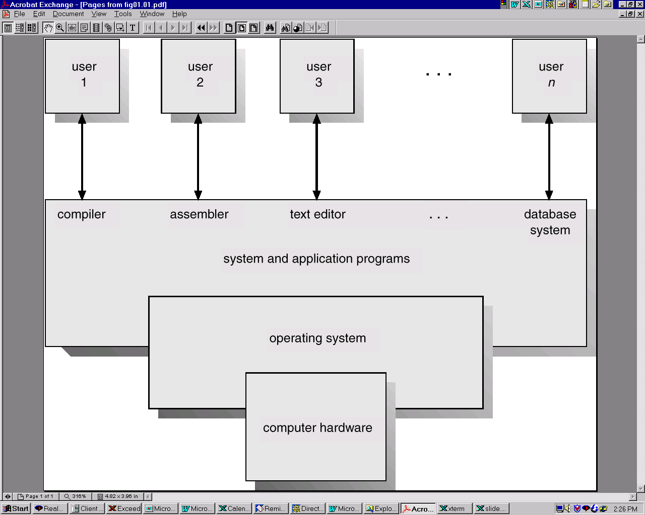
Abstract View of System Components(CO1)

Slide 59
Bare Machine Approach
Types of Operating Systems(CO1)
Machine with no OS.
Computer used to be programmed directly in machine language,
without any system software approach.
Program could be entered into RAM through front-panel switches.
Results of execution could be displayed on a set of LEDs mounted
on front cover itself.

Slide 60
Serial Processing
Types of Operating Systems(CO1)
The programs were executed strictly in a serial manner, wherein
program source code written in assembly or high level language.

Slide 61
Batch Processing
Types of Operating Systems(CO1)
Batch processing is a technique in which an Operating System collects the programs and data together in a batch before processing starts. An operating system does the following activities related to batch processing −
The OS defines a job which has predefined sequence of commands, programs and data as a single unit.
The OS keeps a number of jobs in memory and executes them without any manual information.
Jobs are processed in the order of submission, i.e., first come first served fashion.
When a job completes its execution, its memory is released and the output for the job gets copied into an output pool for later printing or processing.

Slide 62
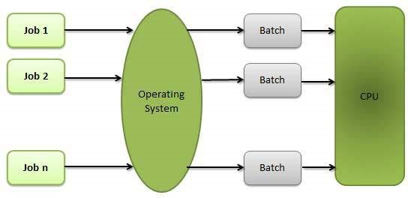
Batch Processing
Types of Operating Systems(CO1)

Slide 63
Batch Processing
Types of Operating Systems(CO1)
Advantages
Batch processing takes much of the work of the operator to the computer.
Increased performance as a new job get started as soon as the previous job is finished, without any manual intervention.
Disadvantages
Difficult to debug program.
A job could enter an infinite loop.
Due to lack of protection scheme, one batch job can affect pending jobs.

Slide 64
Batch Operating System
Types of Operating Systems(CO1)
The users of a batch operating system do not interact with the computer directly. Each user prepares his job on an off-line device like punch cards and submits it to the computer operator.
To speed up processing, jobs with similar needs are batched together and run as a group.
The programmers leave their programs with the operator and the operator then sorts the programs with similar requirements into batches.
The problems with Batch Systems are as follows −
Lack of interaction between the user and the job.
CPU is often idle, because the speed of the mechanical I/O devices is slower than
the CPU.
Difficult to provide the desired priority.

Slide 65
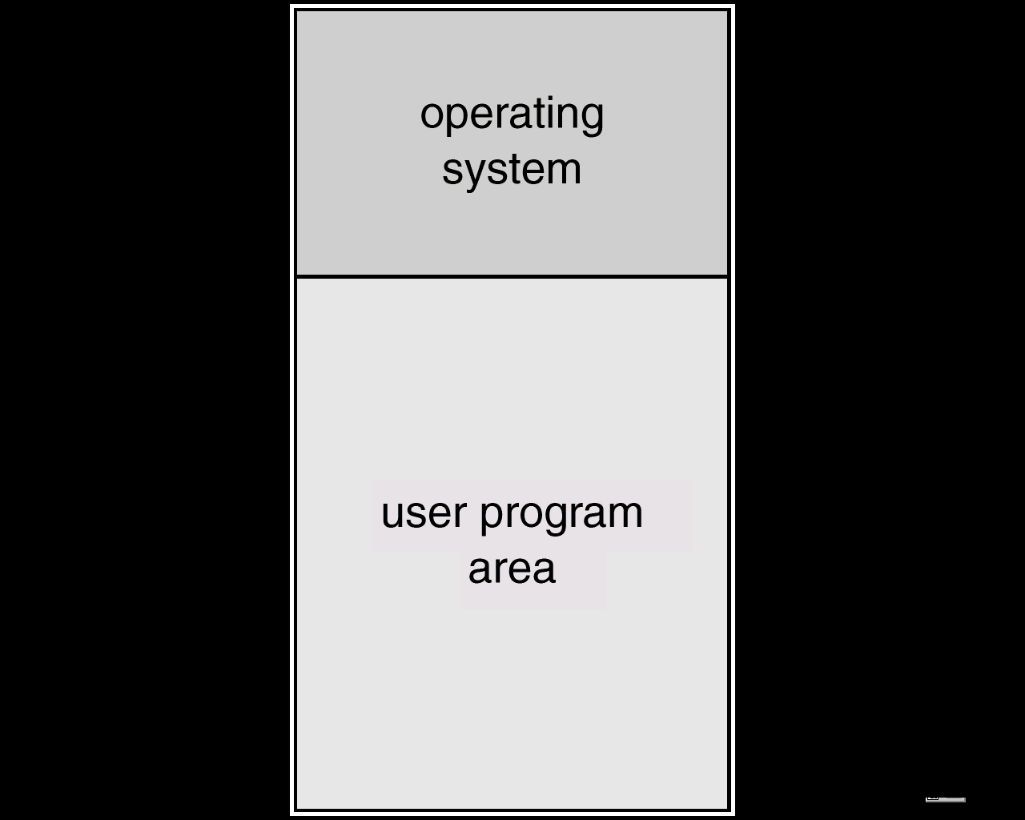
Memory Layout for a Simple Batch System
Simple Batch Systems (continued….)(C01)
Operating System Concepts

Slide 66
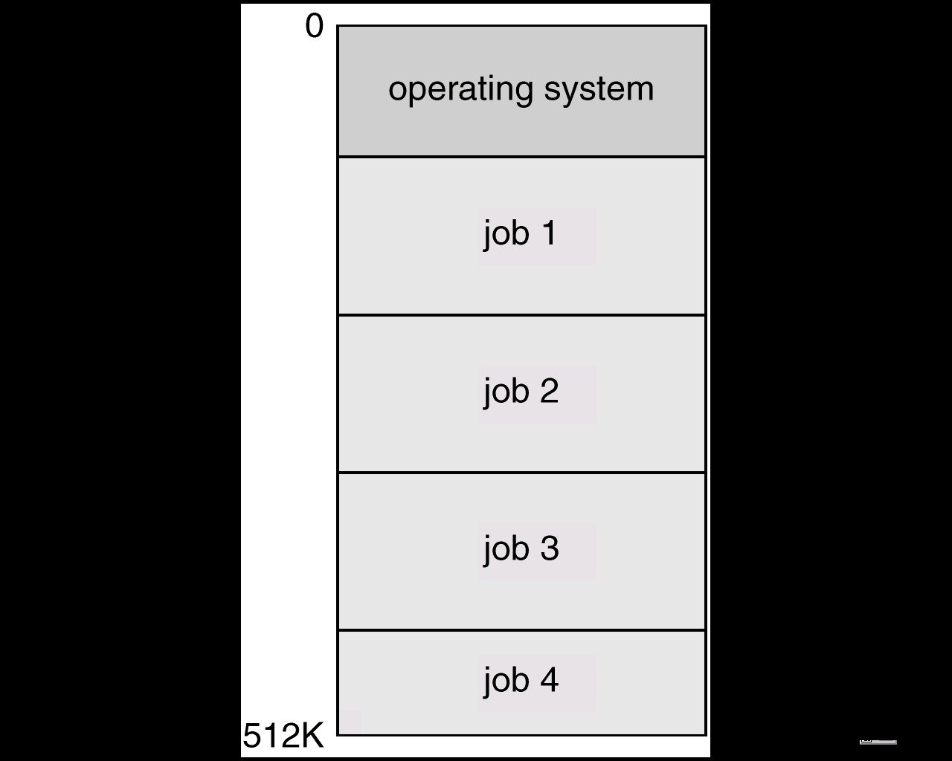
Multi-programmed Batch Systems
Types of Operating Systems(CO1)
Several jobs are kept in main memory at the same time, and the
CPU is multiplexed among them.

Slide 67
Features for Multiprogramming(CO1)
An OS does the following activities related to multiprogramming.
The operating system keeps several jobs in memory at a time.
This set of jobs is a subset of the jobs kept in the job pool.
The operating system picks and begins to execute one of the jobs in the memory.
Multiprogramming operating systems monitor the state of all active programs and system resources using memory management programs to ensure that the CPU is never idle, unless there are no jobs to process.
Advantages
High and efficient CPU utilization.
User feels that many programs are allotted to CPU almost simultaneously.
Disadvantages
CPU scheduling is required.
To accommodate many jobs in memory, memory management is required.

Slide 68
Daily Quiz
Write down various types of Operating System.
Briefly explain about Batch Processing.
What are the various advantages and disadvantages of Batch processing.
Briefly explain Multi Programmed Batch Operating Systems.
Write down advantages and disadvantages of multi programming Operating System.

Slide 69
Daily Quiz
If a process fails, most operating system write the error information to a ______ a) new file b) another running process c) log file d) none of the mentioned
Which one of the following is not a real time operating system? a) RTLinux b) Palm OS c) QNX d) VxWorks

Slide 70
Multitasking
Types of Operating Systems(CO1)
Multitasking is when multiple jobs are executed by the CPU simultaneously by switching between them. Switches occur so frequently that the users may interact with each program while it is running. An OS does the following activities related to multitasking −
The user gives instructions to the operating system or to a program directly, and receives an immediate response.
The OS handles multitasking in the way that it can handle multiple operations/executes multiple programs at a time.
Multitasking Operating Systems are also known as Time-sharing systems.
These Operating Systems were developed to provide interactive use of a computer system at a reasonable cost.
A time-shared operating system uses the concept of CPU scheduling and multiprogramming to provide each user with a small portion of a time-shared CPU.
Each user has at least one separate program in memory.
Operating System Concepts

Slide 71
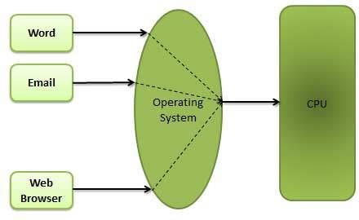
Multitasking
Types of Operating Systems(CO1)
A program that is loaded into memory and is executing is commonly referred to as a process.
When a process executes, it typically executes for only a very short time before it either finishes or needs to perform I/O.
Since interactive I/O typically runs at slower speeds, it may take a long time to complete. During this time, a CPU can be utilized by another process.
The operating system allows the users to share the computer simultaneously. Since each action or command in a time-shared system tends to be short, only a little CPU time is needed for each user.
As the system switches CPU rapidly from one user/program to the next, each user is given the impression that he/she has his/her own CPU, whereas actually one CPU is being shared among many users.
Operating System Concepts

Slide 72
Time-Sharing Systems
Types of Operating Systems(CO1)
The CPU is multiplexed among several jobs that are kept in memory and on disk (the CPU is allocated to a job only if the job is in memory).
A job is swapped in and out of memory to the disk.
On-line communication between the user and the system is provided; when the operating system finishes the execution of one command, it seeks the next “control statement” not from a card reader, but rather from the user’s keyboard.
On-line system must be available for users to access data and code.
Operating System Concepts

Slide 73
Time Sharing Operating Systems
Types of Operating Systems(CO1)
Time-sharing is a technique which enables many people, located at various terminals, to use a particular computer system at the same time.
Time-sharing or multitasking is a logical extension of multiprogramming. Processor's time which is shared among multiple users simultaneously is termed as time-sharing.
The main difference between Multi-programmed Batch Systems and Time-Sharing Systems is that in case of Multi-programmed batch systems, the objective is to maximize processor use, whereas in Time-Sharing Systems, the objective is to minimize response time.
Multiple jobs are executed by the CPU by switching between them, but the switches occur so frequently. Thus, the user can receive an immediate response.
For example, in a transaction processing, the processor executes each user program in a short burst or quantum of computation. That is, if n users are present, then each user can get a time quantum. When the user submits the command, the response time is in few seconds at most.

Slide 74
Time Sharing Operating Systems
Types of Operating Systems(CO1)
The operating system uses CPU scheduling and multiprogramming to provide each user with a small portion of a time. Computer systems that were designed primarily as batch systems have been modified to time-sharing systems.
Advantages of Time-sharing operating systems are as follows −
Provides the advantage of quick response.
Avoids duplication of software.
Reduces CPU idle time.
Disadvantages of Time-sharing operating systems are as follows −
Problem of reliability.
Question of security and integrity of user programs and data.
Problem of data communication.

Slide 75
Real-Time Systems
Types of Operating Systems(CO1)
Often used as a control device in a dedicated application such as controlling scientific experiments, medical imaging systems, industrial control systems, and some display systems.
Well-defined fixed-time constraints.
Hard real-time system. - Hard real-time systems guarantee that critical tasks complete on time. In hard real-time systems, secondary storage is limited or missing and the data is stored in ROM. In these systems, virtual memory is almost never found.
Soft real-time system - Soft real-time systems are less restrictive. A critical real-time task gets priority over other tasks and retains the priority until it completes. Soft real-time systems have limited utility than hard real-time systems. For example, multimedia, virtual reality, Advanced Scientific Projects like undersea exploration and planetary rovers, etc.

Slide 76
Real-Time Operating Systems
Types of Operating Systems(CO1)
A real-time system is defined as a data processing system in which the time interval required to process and respond to inputs is so small that it controls the environment. The time taken by the system to respond to an input and display of required updated information is termed as the response time. So in this method, the response time is very less as compared to online processing.
Real-time systems are used when there are rigid time requirements on the operation of a processor or the flow of data and real-time systems can be used as a control device in a dedicated application.
A real-time operating system must have well-defined, fixed time constraints, otherwise the system will fail.
For example, Scientific experiments, medical imaging systems, industrial control systems, weapon systems, robots, air traffic control systems, etc.

Slide 77
Parallel Systems
Types of Operating Systems(CO1)
Multiprocessor systems with more than one CPU in close communication.
Tightly coupled system – processors share memory and a clock; communication usually takes place through the shared memory.
Advantages of parallel system:
Increased throughput
Economical
Increased reliability
graceful degradation
fail-soft systems

Slide 78
Parallel Systems (Cont..)
Types of Operating Systems(CO1)
Symmetric multiprocessing (SMP)
Each processor runs an identical copy of the operating system.
Many processes can run at once without performance deterioration.
Most modern operating systems support SMP
Asymmetric multiprocessing
Each processor is assigned a specific task; master processor schedules and allocates work to slave processors.
More common in extremely large systems
Operating System Concets

Slide 79
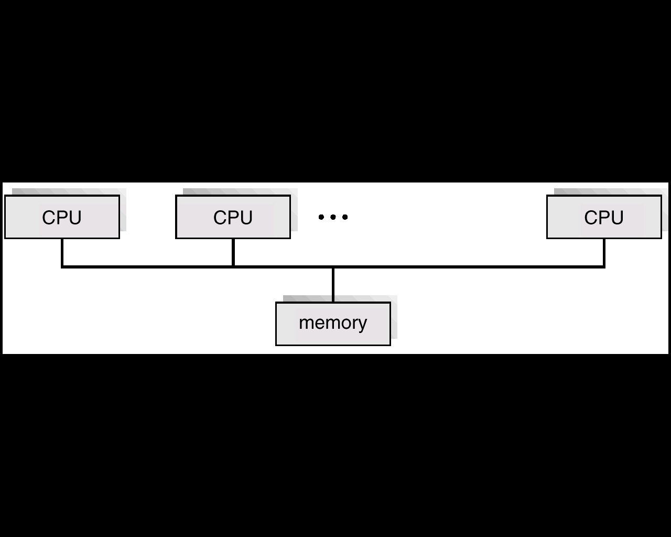
Parallel Systems (Cont.) (CO1)
Symmetric Multiprocessing Architecture

Slide 80
Distributed Systems
Types of Operating Systems(CO1)
Distribute the computation among several physical processors.
Loosely coupled system – each processor has its own local memory; processors communicate with one another through various communication lines, such as high-speed buses or telephone lines.
Advantages of distributed systems.
Resource Sharing
Computation speed up – load sharing
Reliability
Communication

Slide 81
Distributed Systems (Cont..)
Types of Operating Systems(CO1)
Network Operating System
provides file sharing
provides communication scheme
runs independently from other computers on the network
Distributed Operating System
less autonomy between computers
gives the impression there is a single operating system controlling the network.

Slide 82
Network Operating Systems
Types of Operating Systems(CO1)
A Network Operating System runs on a server and provides the server the capability to manage data, users, groups, security, applications, and other networking functions.
The primary purpose of the network operating system is to allow shared file and printer access among multiple computers in a network, typically a local area network (LAN), a private network or to other networks.
Examples of network operating systems include Microsoft Windows Server 2003, Microsoft Windows Server 2008, UNIX, LINUX ,Mac OS X, etc.
The advantages of network operating systems are as follows −
1.Centralized servers are highly stable.
2.Security is server managed.
3.Upgrades to new technologies and hardware can be easily integrated into the system.
4.Remote access to servers is possible from different locations and types of systems.
The disadvantages of network operating systems are as follows −
1.High cost of buying and running a server.
2.Dependency on a central location for most operations.
3.Regular maintenance and updates are required.

Slide 83
Distributed Operating Systems
Types of Operating Systems(CO1)
Distributed systems use multiple central processors to serve multiple real-time applications and multiple users. Data processing jobs are distributed among the processors accordingly.
The processors communicate with one another through various communication lines (such as high-speed buses or telephone lines). These are referred as loosely coupled systems or distributed systems.
Processors in a distributed system may vary in size and function. These processors are referred as sites, nodes, computers, and so on.
The advantages of distributed systems are as follows −
With resource sharing facility, a user at one site may be able to use the resources available at another.
Speedup the exchange of data with one another via electronic mail.
If one site fails in a distributed system, the remaining sites can potentially continue operating.
Better service to the customers.
Reduction of the load on the host computer.
Reduction of delays in data processing.

Slide 84
Interactive Systems
Types of Operating Systems(CO1)
Interactivity refers to the ability of users to interact with a computer system.
An Operating system does the following activities related to interactivity −
Provides the user an interface to interact with the system.
Manages input devices to take inputs from the user. For example, keyboard.
Manages output devices to show outputs to the user. For example, Monitor.
The response time of the OS needs to be short, since the user submits and waits for the result.

Slide 85
Weekly Assignment
What is the distributed Operating System.
Briefly explain about Multi Tasking Operating System.
What is the time sharing Operating Systems.
Explain about Real time Operating Systems.
What is an Interactive systems.

Slide 86
Quiz
Transient operating system code is a code that ____________ a) stays in the memory always b) never enters the memory space c) comes and goes as needed d) is not easily accessible
The operating system is responsible for? a) bad-block recovery b) booting from disk c) disk initialization d) all of the mentioned

Slide 87
Multithreaded System
Types of Operating Systems(CO1)
A thread is a flow of execution through the process code, with its own program counter that keeps track of which instruction to execute next, system registers which hold its current working variables, and a stack which contains the execution history.
A thread shares with its peer threads few information like code segment,
data segment and open files. When one thread alters a code segment,
memory item, all other threads see that.
A thread is also called a lightweight process. Threads provide a way to
improve application performance through parallelism. Threads represent
a software approach to improving performance of operating system by
reducing the overhead, thread is equivalent to a classical process.
Operating System Concets

Slide 88
Multithreaded System
Types of Operating Systems(CO1)
Each thread belongs to exactly one process and no thread can
exist outside a process. Each thread represents a separate
flow of control.
Threads have been successfully used in implementing network
servers and web server.
They also provide a suitable foundation for parallel execution of
applications on shared memory multiprocessors.
Operating System Concets

Slide 89
Process Vs Thread(CO1)
S.No. | Process | Thread
1 | Process is heavy weight or resource intensive. | Thread is light weight, taking lesser resources than a process.
2 | Process switching needs interaction with operating system. | Thread switching does not need to interact with operating system.
3 | In multiple processing environments, each process executes the same code but has its own memory and file resources. | All threads can share same set of open files, child processes.
4 | Multiple processes without using threads use more resources. | Multiple threaded processes use fewer resources.
5 | In multiple processes each process operates independently of the others. | One thread can read, write or change another thread's data.
Operating System Concets

Slide 90
Multithreaded System
Types of Operating Systems(CO1)
Most modern applications are multithreaded.
Threads run within application.
Multiple tasks within the application can be implemented by separate threads
Update display.
Fetch data.
Spell checking.
Answer a network request.
Process creation is heavy-weight while thread creation is light-weight.
Can simplify code, increase efficiency.
Kernels are generally multithreaded.
Operating System Concets

Slide 91
Execution of user computations in different operating systems
Types of Operating Systems(CO1)
OS class | OS overview of computations | Key execution concept
Batch Processing | Job | One job is executed at a time. Programs in a job are executed sequentially.
Multiprogramming | Program | Interleaved execution of programs to obtain balanced utilization of resources.
Time Sharing | Process | Interleaved execution of processes to provide good response to all processes.
Real Time | Process | Interleaved execution of processes in an application program to meet its response requirement.
Distributed | Process | Execution of processes of a program in different nodes to achieve sharing and utilization of resources in the entire system.
Operating System Concets

Slide 92
System Calls(CO1)
System calls provide the interface between a running program and the operating system.
Any single CPU computer can execute only one instruction at a time. If process is running a user program in user mode and needs a system service, such as reading a data from a file , it has to execute a trap instruction to transfer control to the operating system.
Operating system provides services and system call provides interface to these services.
System call is written in language C and C++ as routines. System calls are performed in a
series of steps.
System call is a technique by which a program executing in user mode can request the kernel’s
service.
Ex: Writing a simple program to read data from one file and copy them to another file.
Types of System calls
Here are the five types of system calls used in OS:
Process Control
File Management
Device Management
Information Maintenance
Communications

Slide 93
Process control (CO1)
End , abort
● Load, Execute
● Create process, terminate process
● Wait for time
● Allocate and free memory
● Wait event, signal event
● Get process attributes, set PA

Slide 94
File management , Device management (CO1)
Create file, Delete file
Open , close
Read, write, reposition
Get file attributes
Set file attributes
Device management
Request device , release device
Read , write , reposition
Get device attributes
Set device attributes

Slide 95
System Programs(CO1)
System programs provide a convenient environment for program development and execution.
Some of them provide user interface to system calls and other are considerably more complex. They can be divided into these categories
i) File management
ii) Status information
iii) File manipulation
iv) Programming language support
v) Program loading and execution
vi) Communications

Slide 96
System Boot(CO1)
When power is initialized on system, execution starts at a fixed memory location
Firmware ROM used to hold initial boot code
Operating system must be made available to hardware so hardware can start it
Small piece of code – bootstrap loader, stored in ROM or EEPROM
locates the kernel, loads it into memory, and starts it.
Sometimes two-step process where boot block at fixed location loaded by ROM
code, which loads bootstrap loader from disk.

Slide 97
Bootstrapping(CO1)
The operation of an OS is initialized by the boot procedure when a computer system is switched on. The boot procedure is loaded using a hardware/firmware feature in the computer system and the software technique of bootstrapping.
Bootstrapping is the process of loading a set of instructions when a computer is first turned on or booted. During the startup process, diagnostic tests are performed, such as the power-on self-test (POST), that set or check configurations for devices and implement routine testing for the connection of peripherals, hardware and external memory devices.
The boot loader or bootstrap program is then loaded to initialize the OS.

Slide 98
Daily Quiz
Briefly explain about Multithreaded Operating System.
Define Process.
Explain about Thread.
Briefly explain about System calls.
Explain about Bootstrapping in detail.

Slide 99
Daily Quiz
In real time operating system ____________ a) process scheduling can be done only once b) all processes have the same priority c) kernel is not required d) a task must be serviced by its deadline period
For real time operating systems, interrupt latency should be ____________ a) zero b) minimal c) maximum d) dependent on the scheduling

Slide 100
Interrupt Handling(CO1)
Interrupts are generally called signals which are generated by the software or hardware when a particular event or process requires immediate attention. So, the signal informs the processor about a high priority and urgent information demand causing an interruption in the current working process.
Whenever an interruption occurs the processor finishes the current instruction execution and starts the execution of the interrupt known as interrupt handling. Moreover, for every interrupt handling to occur there is an Interrupt service routine (ISR) or interrupt handler.
The operating system preserves the state of the CPU by storing registers and the program counter.
Determines which type of interrupt has occurred:
polling
vectored interrupt system
Separate segments of code determine what action should be taken for each type of interrupt.

Slide 101
Interrupt Handling(CO1)
Polling: In polling, the first device encountered with the IRQ bit set is the device that is to be serviced first. Appropriate ISR is called to service the same. It is easy to implement but a lot of time is wasted by interrogating the IRQ bit of all devices.
Vectored Interrupts: In vectored interrupts, a device requesting an interrupt identifies itself directly by sending a special code to the processor over the bus. This enables the processor to identify the device that generated the interrupt. The special code can be the starting address of the ISR or where the ISR is located in memory and is called the interrupt vector.

Slide 102
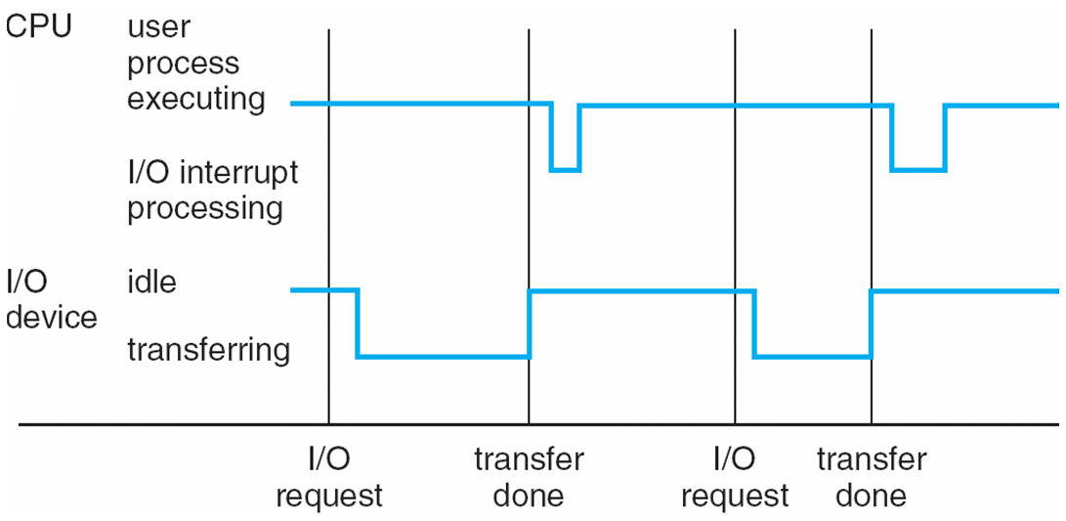
Interrupt Handling(CO1)
Interrupt Timeline

Slide 103
Daily Quiz for Module 1 (Fundamental of Operating System)
For formative assessment 1 (10 questions through Google Quiz)
https://forms.office.com/Pages/ResponsePage.aspx?id=Qzw2YSCEykOPgoAWJ-Fs35C-L_6RWCtNq7l6hvv_qC5UQzJJSTBIQzgwUVRBRVoxMkU4T0IyUFlFUy4u

Slide 104
Daily Quiz
While CPU is executing a program, an interrupt exists then it a) follows the next instruction in the program b) jumps to instruction in other registers c) breaks the normal sequence of execution of instructions d) stops executing the program
Ans c
An interrupt breaks the execution of instructions and diverts its execution to a) Interrupt service routine b) Counter word register c) Execution unit d) control unit
Ans a
While executing the main program, if two or more interrupts occur, then the sequence of appearance of interrupts is called a) multi-interrupt b) nested interrupt c) interrupt within interrupt d) nested interrupt and interrupt within interrupt
Ans d

Slide 105
Operating System Structure (CO1)
General-purpose OS is very large program
● Various ways to structure ones
● Simple structure – MS-DOS
● More complex -- UNIX
● Layered – an abstraction
● Microkernel -Mach

Slide 106
Simple Structure (CO1)
MS-DOS – written to provide the most functionality in the least space
● Not divided into modules
● Although MS-DOS has some structure, its interfaces and
levels of functionality are not well separated

Slide 107
Operating System Structure – Layered Approach(CO1)
The operating system is divided into a number of layers (levels), each built on top of lower layers. The bottom layer (layer 0), is the hardware; the highest (layer N) is the user interface.
With modularity, layers are selected such that each uses functions (operations) and services of only lower-level layers.

Slide 108
An Operating System Layer(CO1)

Slide 109
Layered Structure of the OS(CO1)
A layered design was first used in THE operating system. Its six layers are as follows:

Slide 110
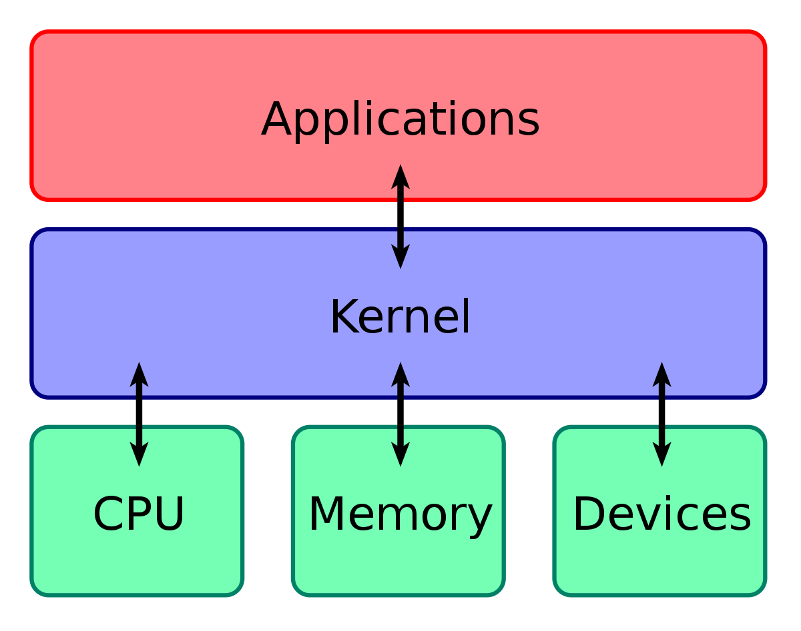
Kernel(CO1)

Slide 111
Kernel(CO1)
The kernel layer consists of OS programs which reside in memory at all times.
Non-kernel programs normally reside on disk and are loaded in memory when needed.
Non-kernel programs use facilities provided by kernel programs.
Programs in the user interface layer similarly use facilities provided by non-kernel programs.
Only the kernel programs interact with computer system hardware.

Slide 112
Monolithic kernel(CO1)
A monolithic kernel is a large single piece of code, composed of several logically different program pieces.
It is one single large program where all the functional components of the operating system have access to all the data and routines. (All those components reside in the kernel space.) Such a program, with the passage of time, grows more and more complex, and becomes difficult to maintain.
To avoid these problems, modern monolithic kernels are structured in strictly functional units. One unit cannot directly access data and routines belonging to other units. The units follow strict communication protocols to avail services from one another.
This is though purely a programming paradigm, and whatever be the internal structure, every part of the operating system runs in the kernel mode on behalf of the running process.

Slide 113
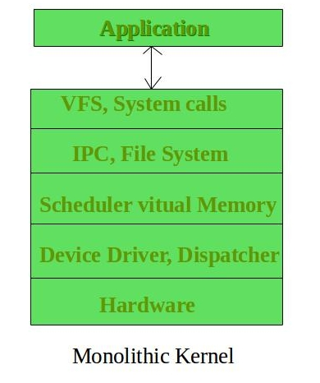
Monolithic kernel(CO1)

Slide 114
Monolithic kernel Architecture(CO1)
Applications
Hardware
Monolithic Kernel

Slide 115
Micro kernel(CO1)
A microkernel system is one that provides only the bare minimum functionalities in the kernel, and hence, is quite small and compact.
The aim is a kernel that provides the most basic functionalities to construct the minimal operating system services; a few inter-process communication and synchronization primitives, a processor scheduler, and an interrupt dispatcher.
The remaining functionalities are implemented through autonomous processes called operating system service processes or Servers.
The server programs reside outside the kernel in different address space. Thus, servers are not truly kernel processes. They are just like any other utility process. They run in the user space, and not in kernel space.
The user-level server processes provide services that have been traditionally parts of monolithic kernel executed by client processes when they operate on the kernel space. They include services such as memory manager, device driver, system call handler, and others. The services offered by the servers are called from the kernel via up calls.
A client does not interact directly with a server. Clients in fact are not aware of servers, and they interact with the operating system via regular system calls. This approach helps in making the kernel smaller. It is easier to develop and test new services or to modify existing services in such systems.

Slide 116
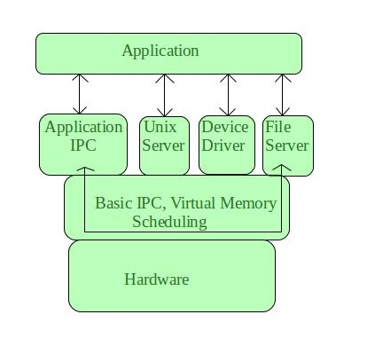
Micro kernel(CO1)

Slide 117
Micro kernel Architecture(CO1)
Applications Server
Microkernel
Hardware

Slide 118
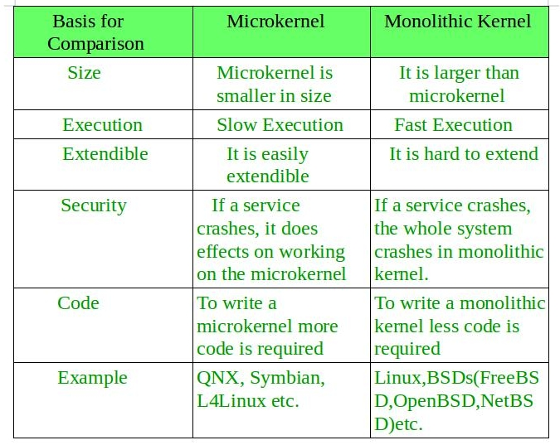
Comparison between Monolithic and Microkernel(CO1)

Slide 119
Re-entrant kernel(CO1)
Several processes may be in kernel mode at the same time. A reentrant kernel is able to suspend the current running process even if process is in the kernel mode.
Unix kernels are reentrant kernel. This means that several processes may be executing in kernel mode at the same time.
A kernel that implements “reentrant routines” are referred to as “Reentrant kernels”. When two tasks can execute the function at the same time without interfering with each other, then the function is reentrant.
In non reentrant kernel mode, every single process acts on its own set of memory locations and thus cannot interfere with others.

Slide 120
Re-entrant Functions(CO1)
Reentrant functions only modify local variables but do not alter global data structures. To provide reentrant kernel, the kernel is implemented as a collection of reentrant functions.
If a hardware interrupt occurs, a reentrant kernel is able to suspend the current running process even if that process is in kernel mode. This capability is very important, because it improves throughput of the device controllers that issues interrupts.

Slide 121
System Components(CO1)
Process Management
Main Memory Management
Secondary-Storage Management
I/O System Management
File Management
Protection System
Networking
Command-Interpreter System

Slide 122
Process Management(CO1)
A process is a program in execution. A process needs certain resources, including CPU time, memory, files, and I/O devices, to accomplish its task.
The operating system is responsible for the following activities in connection with process management.
Process creation and deletion.
process suspension and resumption.
Provision of mechanisms for:
process synchronization
process communication

Slide 123
Main-Memory Management(CO1)
Memory is a large array of words or bytes, each with its own address. It is a repository of quickly accessible data shared by the CPU and I/O devices.
Main memory is a volatile storage device. It loses its contents in the case of system failure.
The operating system is responsible for the following activities in connections with memory management:
Keep track of which parts of memory are currently being used and by whom.
Decide which processes to load when memory space becomes available.
Allocate and deallocate memory space as needed.

Slide 124
Secondary-Storage(CO1)
Since main memory (primary storage) is volatile and too small to accommodate all data and programs permanently, the computer system must provide secondary storage to back up main memory.
Most modern computer systems use disks as the principle on-line storage medium, for both programs and data.
The operating system is responsible for the following activities in connection with disk management:
Free space management
Storage allocation
Disk scheduling

Slide 125
I/O System Management(CO1)
The I/O system consists of:
A buffer-caching system
A general device-driver interface
Drivers for specific hardware devices

Slide 126
File Management(CO1)
A file is a collection of related information defined by its creator. Commonly, files represent programs (both source and object forms) and data.
The operating system is responsible for the following activities in connections with file management:
File creation and deletion.
Directory creation and deletion.
Support of primitives for manipulating files and directories.
Mapping files onto secondary storage.
File backup on stable (nonvolatile) storage media.

Slide 127
Networking (Distributed Systems(CO1)
A distributed system is a collection processors that do not share memory or a clock. Each processor has its own local memory.
The processors in the system are connected through a communication network.
A distributed system provides user access to various system resources.
Access to a shared resource allows:
Computation speed-up
Increased data availability
Enhanced reliability

Slide 128
Command-Interpreter System(CO1)
Many commands are given to the operating system by control statements which deal with:
process creation and management
I/O handling
secondary-storage management
main-memory management
file-system access
protection
networking

Slide 129
Command-Interpreter System (Cont.)(CO1)
The program that reads and interprets control statements is called variously:
control-card interpreter
command-line interpreter
shell (in UNIX)
Its function is to get and execute the next command statement.

Slide 130
Daily Quiz
Briefly explain about Micro Kernel.
Define Kernel.
Explain about Interrupt Handling.
Differentiate Between Monolithic and Microkernel.
Define Process Management in detail.

Slide 131
Daily Quiz
Which one of the following is a real time operating system? a) Windows CE b) RTLinux c) VxWorks d) All of the mentioned
To recover from failures in the network operations _____________ information may be maintained. a) operating system b) ip address c) stateless d) state

Slide 132
Operating System Services(CO1)
Program execution – system capability to load a program into memory and to run it.
I/O operations – since user programs cannot execute I/O operations directly, the operating system must provide some means to perform I/O.
File-system manipulation – program capability to read, write, create, and delete files.
Communications – exchange of information between processes executing either on the same computer or on different systems tied together by a network. Implemented via shared memory or message passing.
Error detection – ensure correct computing by detecting errors in the CPU and memory hardware, in I/O devices, or in user programs.

Slide 133
Additional Operating System Functions(CO1)
Additional functions exist not for helping the user, but rather for ensuring efficient system operations.
Resource allocation – allocating resources to multiple users or multiple jobs running at the same time.
Accounting – keep track of and record which users use how much and what kinds of computer resources for account billing or for accumulating usage statistics.
Protection – ensuring that all access to system resources is controlled.

Slide 134
Operating System Services(CO1)
Program execution – Operating systems handle many kinds of activities from user programs to system programs like printer spooler, name servers, file server, etc. Each of these activities is encapsulated as a process.
A process includes the complete execution context (code to execute, data to manipulate, registers, OS resources in use). Following are the major activities of an operating system with respect to program management −
Loads a program into memory.
Executes the program.
Handles program's execution.
Provides a mechanism for process synchronization.
Provides a mechanism for process communication.
Provides a mechanism for deadlock handling.

Slide 135
Operating System Services(CO1)
I/O Operation
An I/O subsystem comprises of I/O devices and their corresponding driver software. Drivers hide the peculiarities of specific hardware devices from the users.
An Operating System manages the communication between user and device drivers.
I/O operation means read or write operation with any file or any specific I/O device.
Operating system provides the access to the required I/O device when required.

Slide 136
Operating System Services(CO1)
File system manipulation
A file represents a collection of related information. Computers can store files on the disk (secondary storage), for long-term storage purpose. Examples of storage media include magnetic tape, magnetic disk and optical disk drives like CD, DVD. Each of these media has its own properties like speed, capacity, data transfer rate and data access methods.
A file system is normally organized into directories for easy navigation and usage. These directories may contain files and other directories. Following are the major activities of an operating system with respect to file management −
Program needs to read a file or write a file.
The operating system gives the permission to the program for operation on file.
Permission varies from read-only, read-write, denied and so on.
Operating System provides an interface to the user to create/delete files.
Operating System provides an interface to the user to create/delete directories.
Operating System provides an interface to create the backup of file system.

Slide 137
Operating System Services(CO1)
Communication
In case of distributed systems which are a collection of processors that do not share memory, peripheral devices, or a clock, the operating system manages communications between all the processes. Multiple processes communicate with one another through communication lines in the network.
The OS handles routing and connection strategies, and the problems of contention and security. Following are the major activities of an operating system with respect to communication −
Two processes often require data to be transferred between them
Both the processes can be on one computer or on different computers, but are connected through a computer network.
Communication may be implemented by two methods, either by Shared Memory or by Message Passing.

Slide 138
Operating System Services(CO1)
Error Handling
Errors can occur anytime and anywhere. An error may occur in CPU, in I/O devices or in the memory hardware. Following are the major activities of an operating system with respect to error handling −
The OS constantly checks for possible errors.
The OS takes an appropriate action to ensure correct and consistent computing.
Resource Management
In case of multi-user or multi-tasking environment, resources such as main memory, CPU cycles and files storage are to be allocated to each user or job. Following are the major activities of an operating system with respect to resource management −
The OS manages all kinds of resources using schedulers.
CPU scheduling algorithms are used for better utilization of CPU.

Slide 139
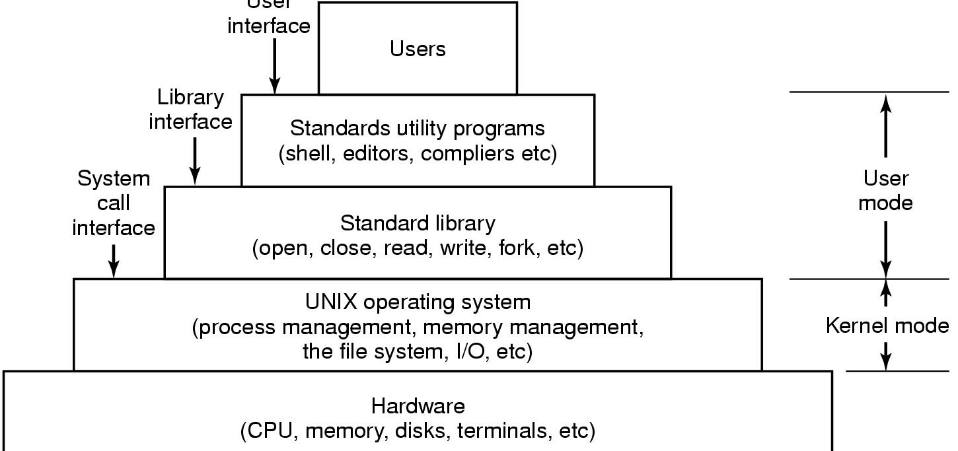
Case Studies: Windows, Unix and Linux
User Interface

Slide 140
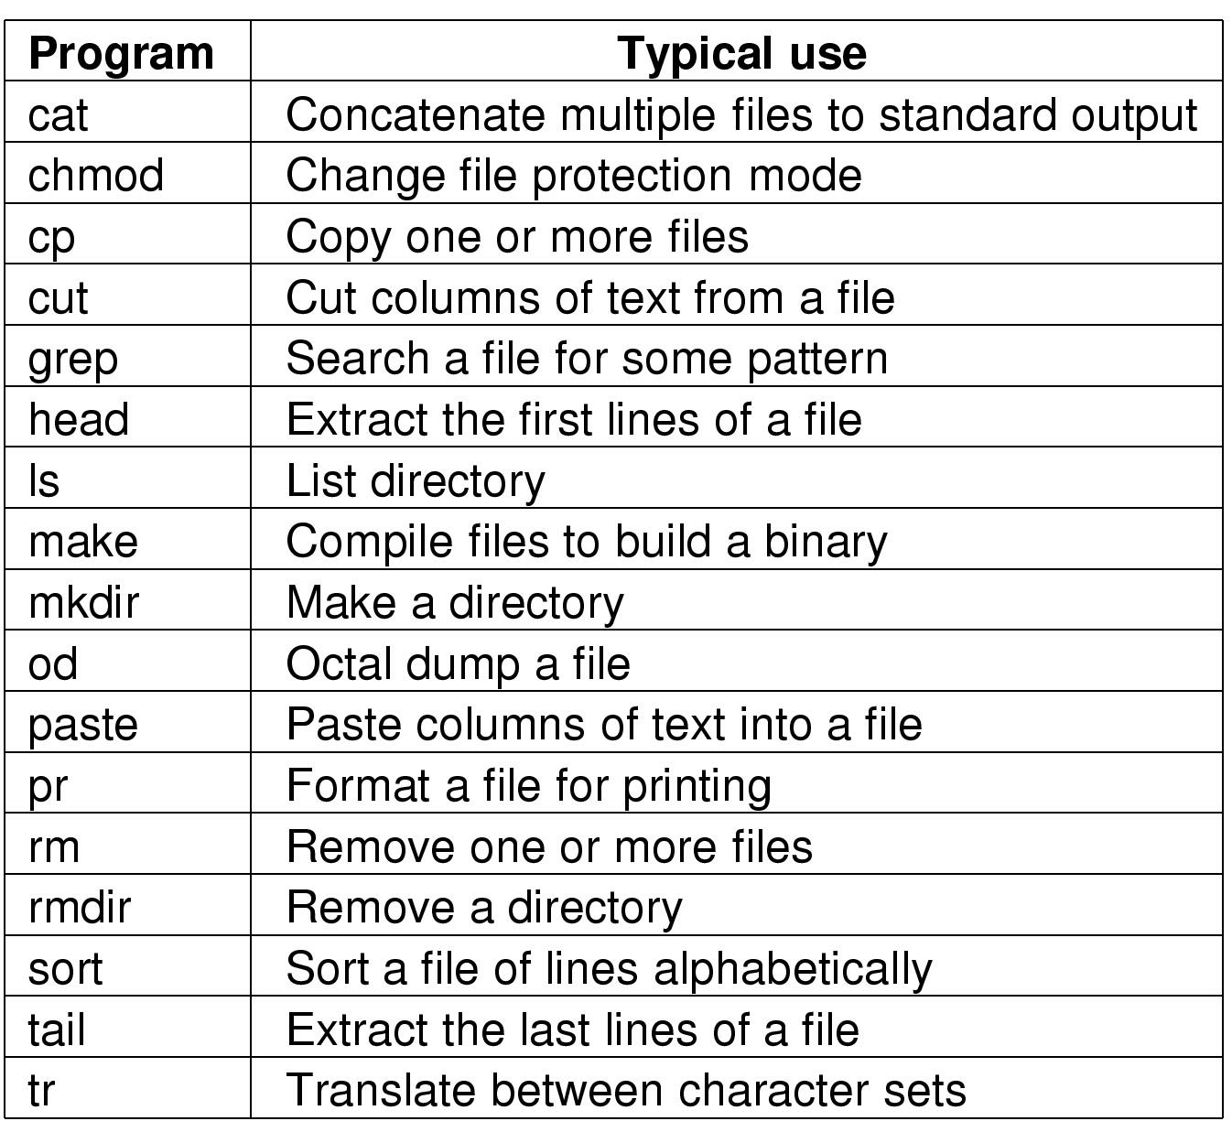
Case Studies: Windows, Unix and Linux
UNIX Utility Programs

Slide 141
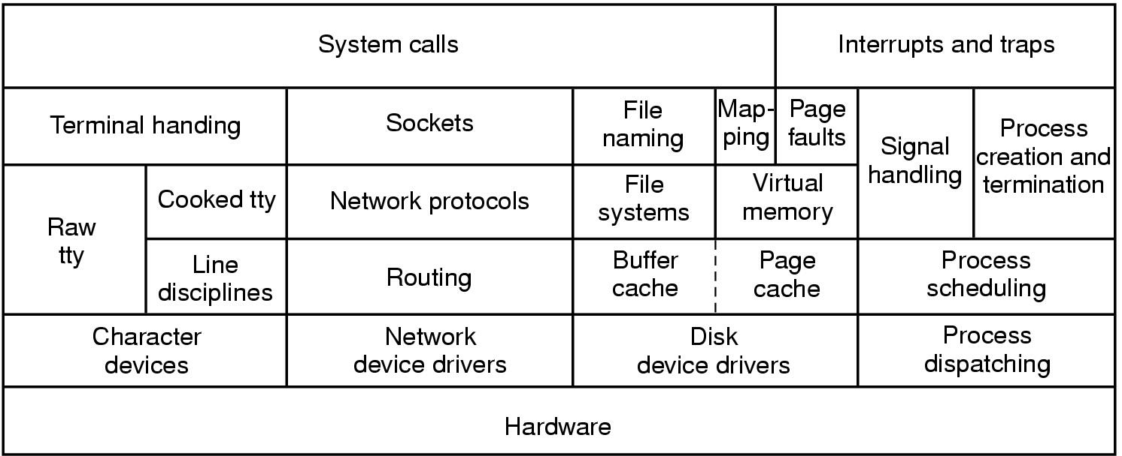
Case Studies: Windows, Unix and Linux
UNIX Kernel

Slide 142
Faculty Video Links, Youtube & NPTEL Video Links and Online Courses Details
Youtube/other Video Links
https://www.youtube.com/playlist?list=PLBlnK6fEyqRiVhbXDGLXDk_OQAeuVcp2O
https://nptel.ac.in/courses/106108101

Slide 143
Daily Quiz
1.When a computer is first turned on or restarted, a special type of absolute loader called ____ is executed A. Compile and Go loader B. Boot loader C. Bootstrap loader D. Relating loader
2.To access the services of operating system, the interface is provided by the ___________
System calls
API
Library
Assembly instructions

Slide 144
Daily Quiz
3. What are the characteristics of Host based IDS? a) Logs are analysed to detect tails of intrusion b) The host operating system logs in the audit information c) Logs includes logins, file opens, and program executions d) All of the mentioned
4. Hard real time operating system has ______________ jitter than a soft real time operating system. a) equal b) more c) less d) none of the mentioned

Slide 145
Daily Quiz
5. In real time operating system ____________ a) all processes have the same priority b) a task must be serviced by its deadline period c) process scheduling can be done only once d) kernel is not required
6. The problem of priority inversion can be solved by ____________ a) priority inheritance protocol b) priority inversion protocol c) both priority inheritance and inversion protocol d) none of the mentioned

Slide 146
Daily Quiz
7. Buffering is done to ____________ a) cope with device speed mismatch b) cope with device transfer size mismatch c) maintain copy semantics d) all of the mentioned
8. The ________ keeps state information about the use of I/O components. a) CPU b) OS c) kernel d) shell

Slide 147
Daily Quiz
9. Which one of the following bootloader is not used by linux? a) GRUB b) LILO c) NTLDR d) None of the mentioned
10. Linux uses a time-sharing algorithm ___________ a) to pair pre-emptive scheduling between multiple processes b) for tasks where absolute priorities are more important than fairness c) all of the mentioned d) none of the mentioned

Slide 148
Weekly Assignment
List the advantages of multiprocessor system?
List the services provided by an Operating System.
Describe differences between symmetric and asymmetric multiprocessing.
Mention the objectives and functions of OS.
What is Process Management.
Briefly Explain about Storage Management.
Explain about Real Time Operating Systems.
What is the distributed Operating systems.
What is an Interactive System.
Briefly explain about Bootstrapping.
Define Micro Kernel.

Slide 149
Glossary Questions
Choose the correct
1.The multi-user Operating System is based on the concept of ____
2. Operating system_________
3. ____ systems have more than one CPU in close communication with the others.
4. On systems where there are multiple operating system, the decision to load a particular one is done by _____________
(Multiprocessor, Provides a layer and user friendly interface, boot loader, Time-sharing, )

Slide 150
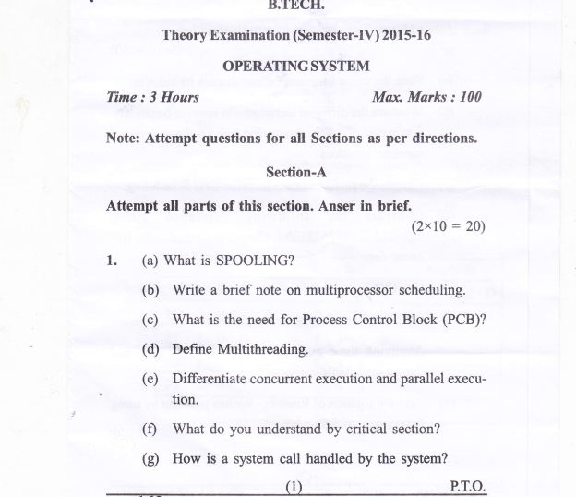
Old Question Papers

Slide 151
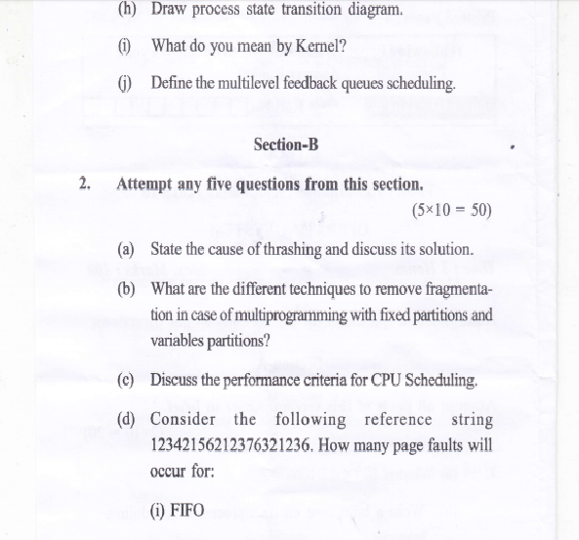
Old Question Papers
)
Operating System Concets

Slide 152
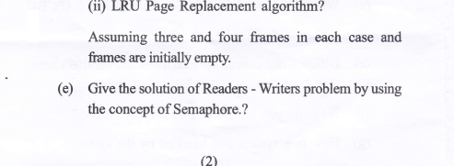
Old Question Papers
Operating System Concets

Slide 153
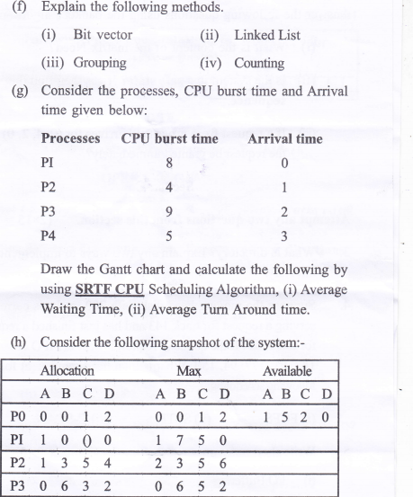
Old Question Papers
Operating System Concets

Slide 154
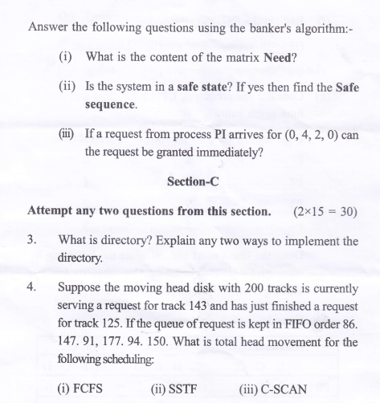
Old Question Papers
Operating System Concets

Slide 155
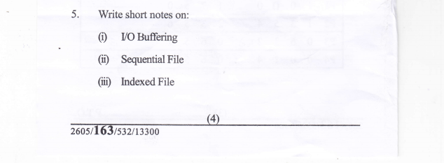
Old Question Papers
Operating System Concets

Slide 156
Expected Questions for University Exam
1. Distinguish between Monolithic and Micro Kernel.
2. Explain Briefly Layered operating system structure with neat sketch.
3. Describe differences between symmetric and asymmetric multiprocessing.
4. List the services provided by an Operating System.
List the Components of Operating System.
Define System calls.
Distinguish between batch systems and time sharing systems.
Describe parallel systems and give their advantages.
Differentiate between Multi programming and Multi Tasking.
Mention the objectives and functions of OS.
Operating System Concets

Slide 157
Recap of Unit
In this module,
we have studied the following:
Overview and Concepts of Operating system
What is Operating system
Types of operating system
Layered architecture of Operating system
System components
OS services
System calls and types of system calls
Kernel
Monolithic Kernel
Micro Kernel
Reentrant kernel
Operating System Concets

Slide 158
References
Books :
Silberschatz, Galvin and Gagne, “Operating Systems Concepts”, Wiley
SibsankarHalder and Alex A Aravind, “Operating Systems”, Pearson Education
Harvey M Dietel, “ An Introduction to Operating System”, Pearson Education
D M Dhamdhere, “Operating Systems : A Concept basedApproach”, McGraw Hill.
Charles Crowley, “Operating Systems: A Design-Oriented Approach”, Tata McGraw Hill Education”.
Stuart E. Madnick & John J. Donovan, “ Operating Systems”, Tata McGraw
Operating System Concets

